Slide 1



AAJ GLOBAL FUTURE AND EMERGING TECH
Index
Aakash Sawant
Aryaman Utkarsh Gangwar
James Schiemmel

Slide 2
CONTENT
Objective
The Rise of Tech Stocks
Methodology
Sectors/industries and components
Performance Attribution
Performance vs index
The rationale behind Equal Weighting
The rationale behind ROIC 20%
Pros/Cons

Slide 3
OBJECTIVE
Global exposure to companies on the cutting edge of new technologies
High quality through ROIC to focus on companies that can convert new technologies into growth
Large cap companies that have the resources to implement

Slide 4


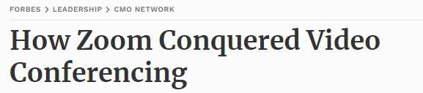
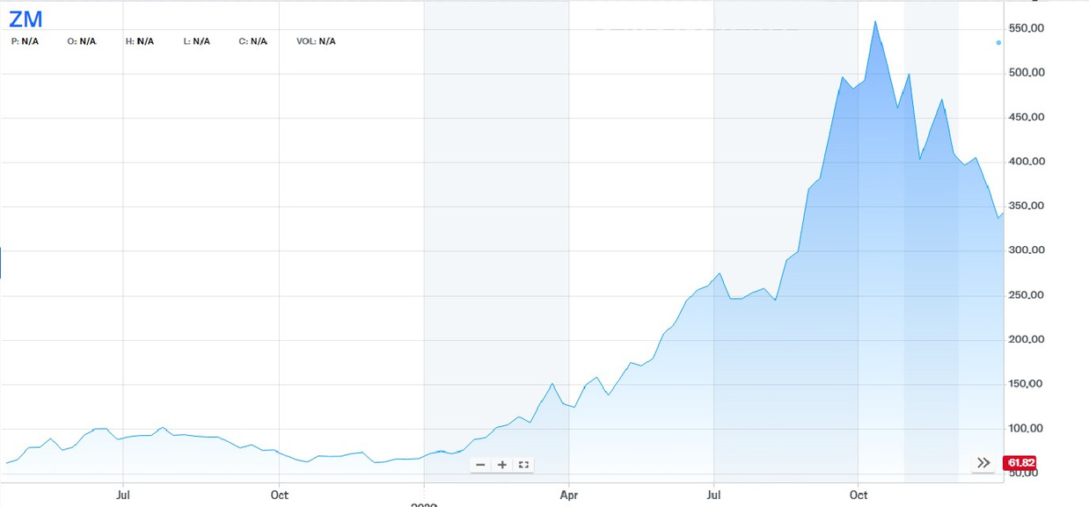
THE RISE OF TECH STOCK

Slide 5
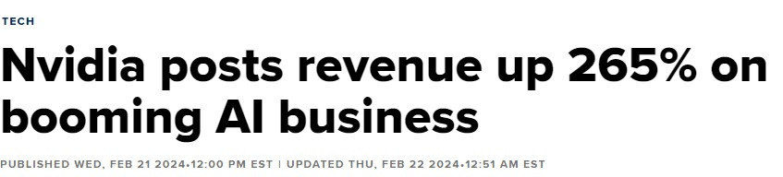
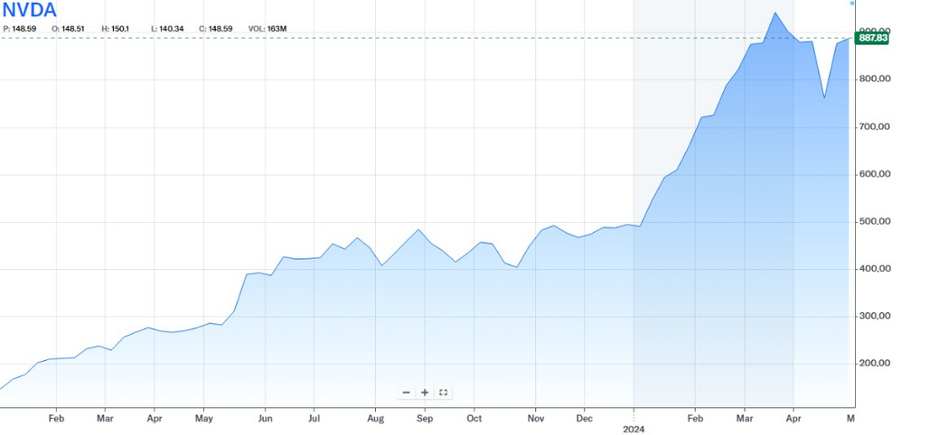
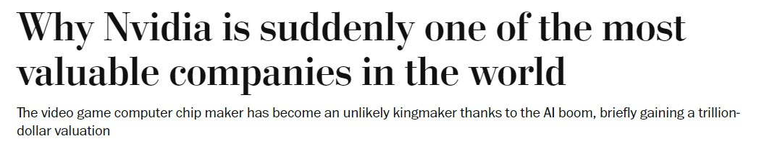
THE RISE OF TECH STOCK

Slide 6

METHODOLOGY
Base Universe: Global
Theme: Technologies that are in a position to massively increase in viability or efficiency
3D Printing | 5G | AI Ecosystem | Big Data | Blockchain | Cloud Computing | Genome Editing | Nanotechnology | Laser Technology
Robotics | Virtual and Augmented Reality | Agricultural Biotech | Cyber Security | Electric Vehicles | Green Energy Utilities | Human Augmentation Technology | Medical Biotech | Metaverse
NFTs | Social Media | Clean Tech | Energy Tech

Slide 7
METHODOLOGY
Minimum Free-Float Adjusted Market Capitalization: 33,000 Million USD
Guarantees component companies have the resources to devote to RND to achieve critical growth
Quality: Require return on invested capital to be greater than or equal to 20%
Weighting: Equal weighted
Under alternative methods gain overexposure to a very small number of stocks
Rebalancing and Reconstitution: Quarterly

Slide 8
Total Constituents- 62
CONSTITUENTS
Company | Price | Market Capitalization | Sector
Microsoft Corporation | 415.50 | 3,087,346,253,149.50 | Technology
Apple Inc. | 179.66 | 2,774,288,340,460.00 | Technology
NVIDIA Corporation | 822.79 | 2,056,975,000,000.00 | Technology
Meta Platforms, Inc. | 502.30 | 1,105,084,565,986.10 | Technology
Alphabet Inc. | 137.14 | 808,166,020,000.00 | Technology
Alphabet Inc. | 138.08 | 783,051,680,000.00 | Technology
Eli Lilly and Company | 782.12 | 743,142,621,198.24 | Pharmaceuticals - Major
Taiwan Semiconductor Manufacturing Company Limited | 133.90 | 694,460,861,165.76 | Semiconductor Manufacturing
Broadcom Inc. | 1,399.17 | 648,404,661,228.93 | Semiconductors
Taiwan Semiconductor Manufacturing Company Limited | 21.80 | 565,435,504,828.14 | Semiconductor Manufacturing
Company | Price | Market Capitalization | Sector
Microsoft Corporation | 415.50 | 3,087,346,253,149.50 | Technology
Apple Inc. | 179.66 | 2,774,288,340,460.00 | Technology
NVIDIA Corporation | 822.79 | 2,056,975,000,000.00 | Technology
Meta Platforms, Inc. | 502.30 | 1,105,084,565,986.10 | Technology
Alphabet Inc. | 137.14 | 808,166,020,000.00 | Technology
Alphabet Inc. | 138.08 | 783,051,680,000.00 | Technology
Eli Lilly and Company | 782.12 | 743,142,621,198.24 | Pharmaceuticals - Major
Taiwan Semiconductor Manufacturing Company Limited | 133.90 | 694,460,861,165.76 | Semiconductor Manufacturing
Broadcom Inc. | 1,399.17 | 648,404,661,228.93 | Semiconductors
Taiwan Semiconductor Manufacturing Company Limited | 21.80 | 565,435,504,828.14 | Semiconductor Manufacturing

Slide 9
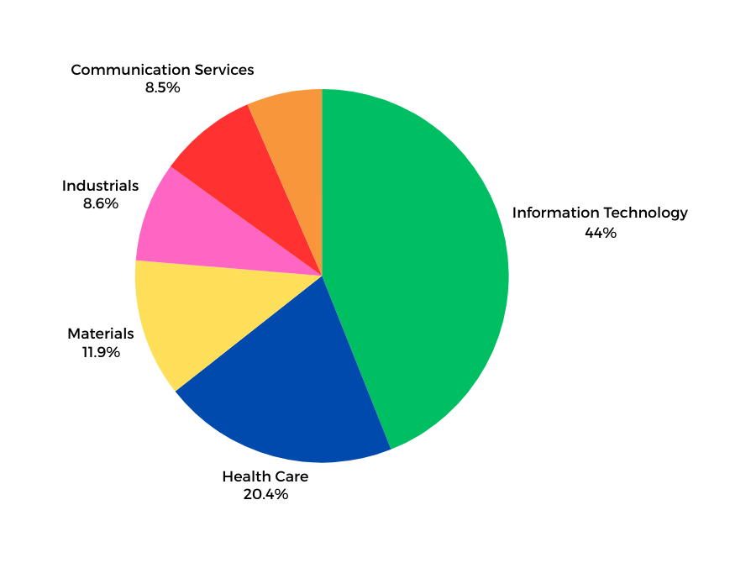
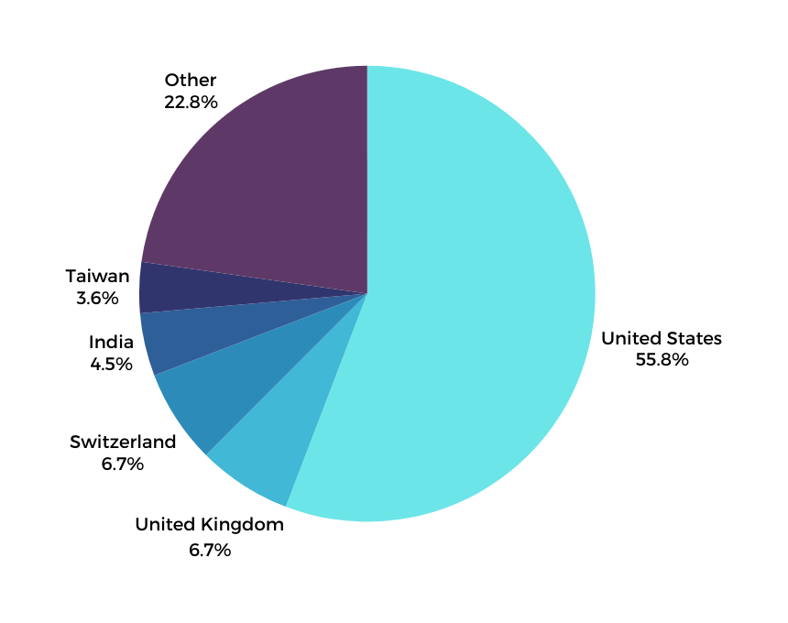
COMPONENTS
By Country
By Sector

Slide 10
PERFORMANCE ATTRIBUTION
Sector | Relative Allocation | Return in Portfolio | Allocation Effect | Selection Effects
Energy | -0.0364 | -0.0002 | -0.0436 | -0.0502
Materials | 0.0814 | 0.0996 | 0.054 | 0.0068
Utilities | -0.0294 | 0 | -0.0079 | -0.0079
Financials | -0.1296 | 0.0443 | -0.1254 | 0.0288
Health Care | 0.169 | 0.3064 | 0.1404 | 0.0217
Sector | Relative Allocation | Return in Portfolio | Allocation Effect | Selection Effects
Industrials | -0.0576 | 0.0143 | -0.0493 | -0.0438
Real Estate | -0.0289 | 0 | -0.0156 | -0.0156
Consumer Staples | -0.0741 | 0 | -0.0378 | -0.0378
Communication Services | -0.0391 | 0.0857 | -0.048 | 0.0169
Consumer Discretionary | -0.0784 | 0.0193 | -0.075 | -0.0009
Information Technology | 0.2231 | 0.6001 | 0.2824 | 0.0307

Slide 11
PERFORMANCE VS INDEX
Category | Index | Benchmark
Index Returns
Return | 125.67% | 106.3%
Annualized Return | 13.68% | 12.08%
Sharpe Ratio | 2.08 | 1.92
Index Volatility
Daily Volatility | 1.19% | 1.28%
Annualized Volatility | 18.95% | 20.27%
Max Drawdown | -28.89% | -34.06%
Relative Statistics
Tracking Error | 7.36%
Beta | 0.87
Annualized Information Ratio | 0.22
iShares Edge MSCI USA Quality Factor ETF

Slide 12
PERFORMANCE VS INDEX
Category | Index | Benchmark
Index Returns
Return | 125.67% | 174.61%
Annualized Return | 13.68% | 17.25%
Sharpe Ratio | 2.08 | 1.80
Index Volatility
Daily Volatility | 1.19% | 1.62%
Annualized Volatility | 18.95% | 25.72%
Max Drawdown | -28.89% | -36.3%
Relative Statistics
Tracking Error | 10.73%
Beta | 0.69
Annualized Information Ratio | 0.33
iShares Global Tech ETF

Slide 13
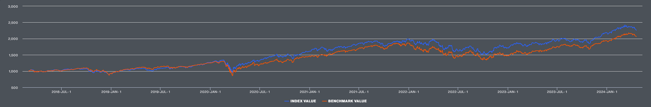
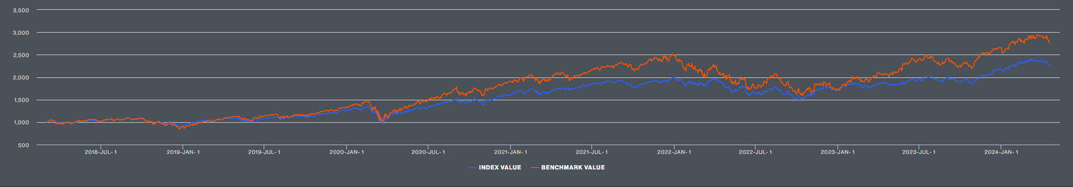
PERFORMANCE VS INDEX
iShares Edge MSCI USA Quality Factor ETF
iShares Global Tech ETF

Slide 14
THE RATIONALE BEHIND EQUAL WEIGHTING
Equal Weighting
Market-Cap Weighting
Style Factor | Index | Benchmark
Momentum | -0.47 | -0.09
Value | -0.21 | 0.15
Size | 0.64 | 0.43
Quality | 0.65 | -0.07
Low Volatility | -0.51 | -0.08
Liquidity | 0.68 | 0.48
Yield | -0.55 | -0.14
Style Factor | Index | Benchmark
Momentum | -0.11 | -0.50
Value | -0.06 | -0.31
Size | 0.53 | 0.57
Quality | 0.30 | 0.53
Low Volatility | -0.40 | -0.55
Liquidity | 0.59 | 0.64
Yield | -0.22 | -0.53

Slide 15
THE RATIONALE BEHIND ROIC 20%
Roic | Sharpe Ratio | 1 yr Return | 1 yr Volatility | Max Return | Max Volatility | Components
5 | 2.09 | 19.07 | 0.67 | 94.17 | 1.09 | 169
10 | 2.07 | 21.69 | 0.7 | 109.2 | 1.13 | 127
15 | 2.09 | 24.02 | 0.76 | 118.99 | 1.17 | 80
20 | 2.11 | 25.09 | 0.77 | 133.69 | 1.2 | 60
No Roic | 2.08 | 21.44 | 0.7 | 98.39 | 1.1 | 201

Slide 16
PROS/CONS
Pros
Cons
Exposure to a large number of companies with the potential for dramatic price appreciation
Focus on future innovation
Highly Diversified, global universe and equal weighting mitigate geographic and concentration risk
Large Quality Focus, the companies within the index have high market caps and reliable returns on investment
Highly concentrated on technology
Market cap threshold may prevent the inclusion of smaller companies that lead innovation
Focus on ROIC may exclude companies that are not currently profitable but will be soon
Equal weighting may reduce the amount of gain from riding stock growth up

Slide 17
THANK YOU,
QUESTIONS?

